Slide 1

Chapter 9

Slide 2
Designing the Database
Chapter 9
Systems Analysis and Design in a Changing World 7th Ed
Satzinger, Jackson & Burd

Slide 3
Overview
Databases and database management systems are important components of a modern information system
Database design transforms the domain model class diagram into a detailed database model for the system
A database management system is used to implement and interact with the database

Slide 4
Databases and DBMSs
Database (DB) -- an integrated collection of stored data that is centrally managed and controlled
Database management system (DBMS) -- a system software component that manages and controls one or more databases
Schema -- database component that contains descriptive information about the data stored in the physical data store (sometimes called metadata)
Structured Query Language -- the standard query language to access and update data in a relational DBMS

Slide 5
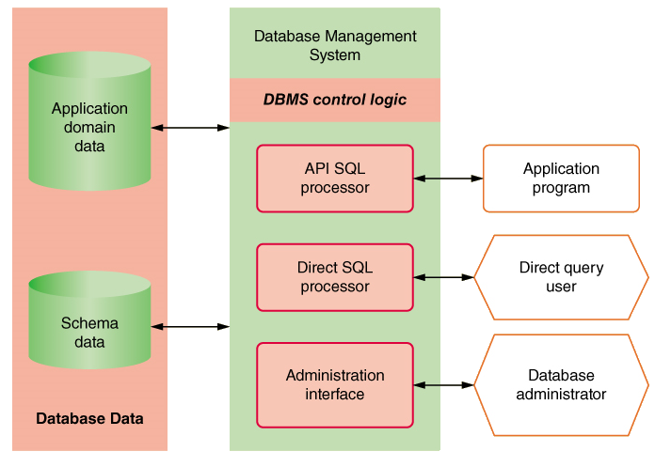
DBMS Components

Slide 6
Database Schema
Organization of individual stored data items into higher level groups, such as tables
Associations among tables or classes
Details of physical data store organization, including types, lengths, locations, and indexing of data items
Access and content controls, including allowable values for specific data items, value dependencies among multiple data items, and lists of users allowed to read or update data items

Slide 7
Characteristics of a DBMS
Simultaneous access by many users and many applications
Direct access to data with a data interface
Uniform and consistent access
Integration and distribution of data across multiple servers

Slide 8
Database Design and Administration
Who is involved in database design?
Data Administrator (DA) – person in charge of structure and integrity of the data
Data standards – naming, definition, data typing
Data use – ownership, accessibility, confidentiality
Data quality – validation rules, completeness, currency

Slide 9
Database Design and Administration
Who is involved in database design?
Database Administrator (DBA) – person in charge of safety and the operation of the database
Manage multiple DBMS environment
Protect the database and data – authentication
Maintain high-performance level
Backup data and define recovery procedures

Slide 10
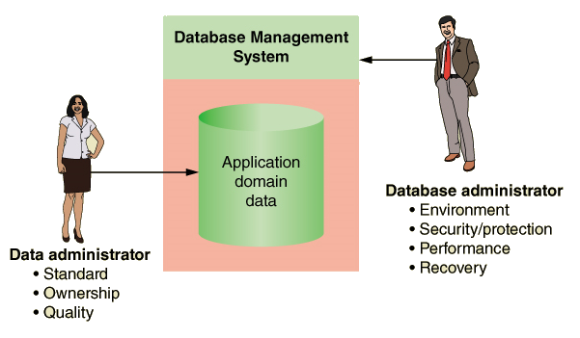
DA and DBA Responsibilities

Slide 11
Relational Databases
Relational database management system (RDBMS) -- a DBMS that organizes data in tables (relations)
Table -- a two-dimensional data structure of columns and rows
Row -- one horizontal group of data attribute values
Attribute -- one vertical group of data attribute values
Attribute value -- the value held in a single table cell

Slide 12
Relational Databases
Key – an attribute or set of attributes, the values of which occur only once in all the rows of the table
Candidate Key – an attribute or set of attributes that could server as the primary key
Primary key – the key chosen by a database designer to represent relationships among rows in different tables
Foreign key – an attribute that duplicates the primary key of a different (or foreign) table

Slide 13
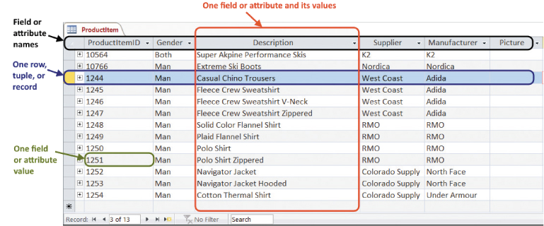
Partial Display of a Relational Database Table

Slide 14
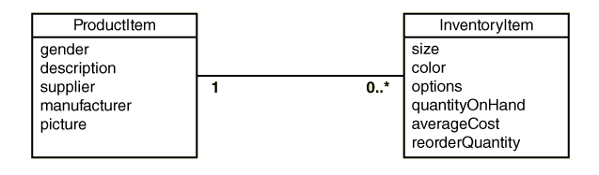
An Association Between Two Classes

Slide 15
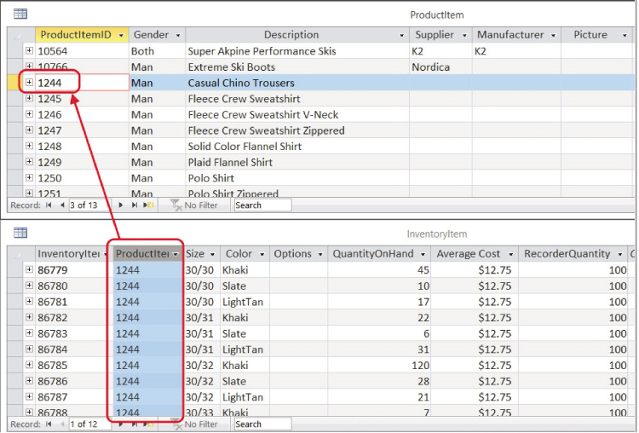
An Association Between Rows in Two Tables (key and foreign key)

Slide 16
Designing Relational Databases Based on the Domain Model Class Diagram
Create a table for each class
Choose a primary key for each table (invent one, if necessary)
Add foreign keys to represent one-to-many associations
Create new tables to represent many-to-many associations
Represent classification hierarchies
Define referential integrity constraints
Evaluate schema quality and make necessary improvements
Choose appropriate data types
Incorporate integrity and security controls

Slide 17
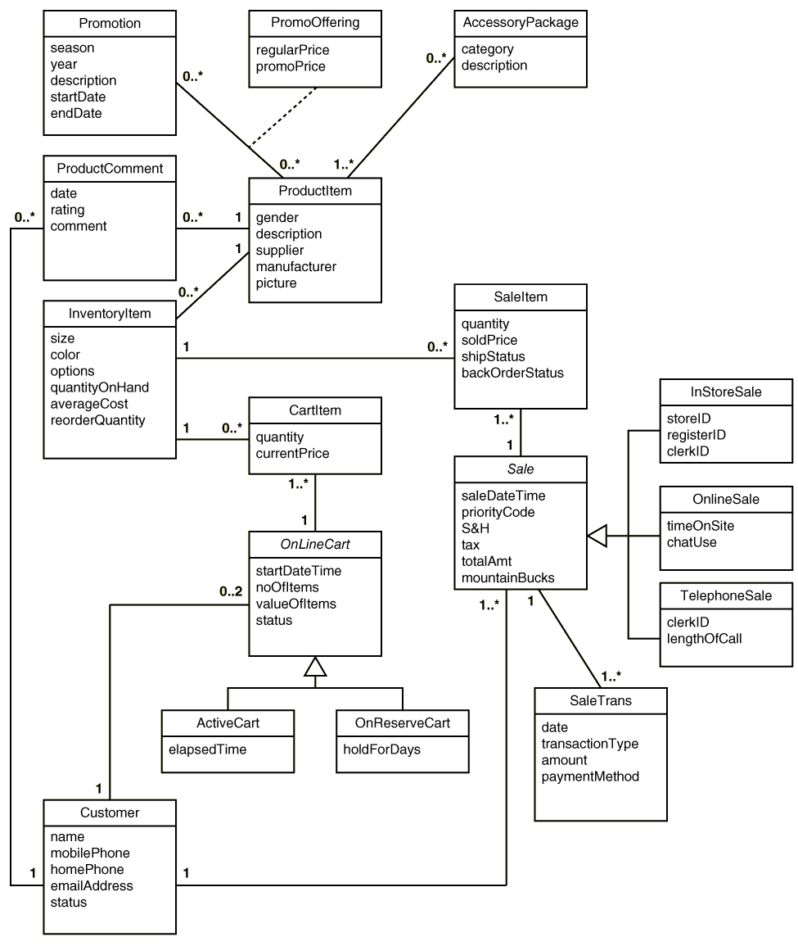
RMO Classes

Slide 18
Initial Set of Tables Based on RMO Domain Classes

Slide 19
Initial Set of Tables With Primary Keys Added (bold)

Slide 20
Representing Associations
One-to-Many – Add primary key attribute of the “one” class to the “many” class as a foreign key
Many-to-Many –
With an Association Class – Add primary keys of endpoint classes as foreign keys and as candidate keys. May also become primary key
Without an Association Class – Create new table. Add primary keys of endpoint classes as foreign keys and as candidate keys.

Slide 21
Initial Set of Tables With Foreign Keys Added (in italics)

Slide 22
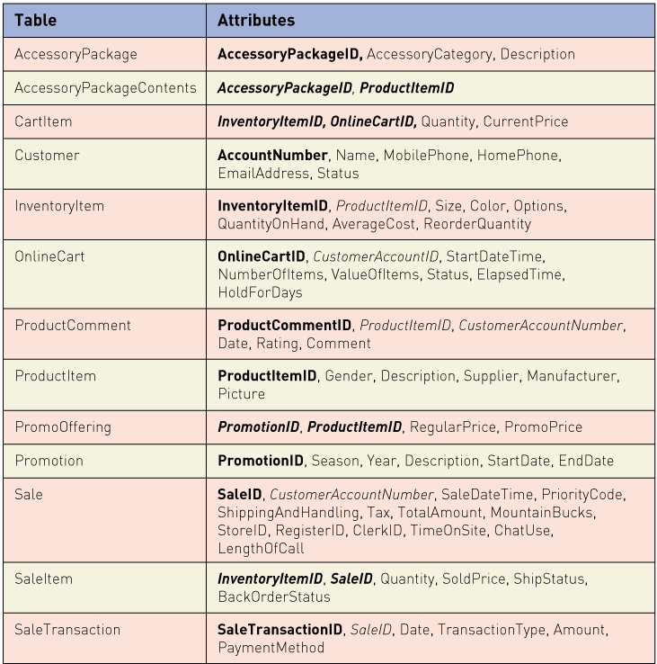
Association Class PromoOffering added from association class to table with two keys

Slide 23
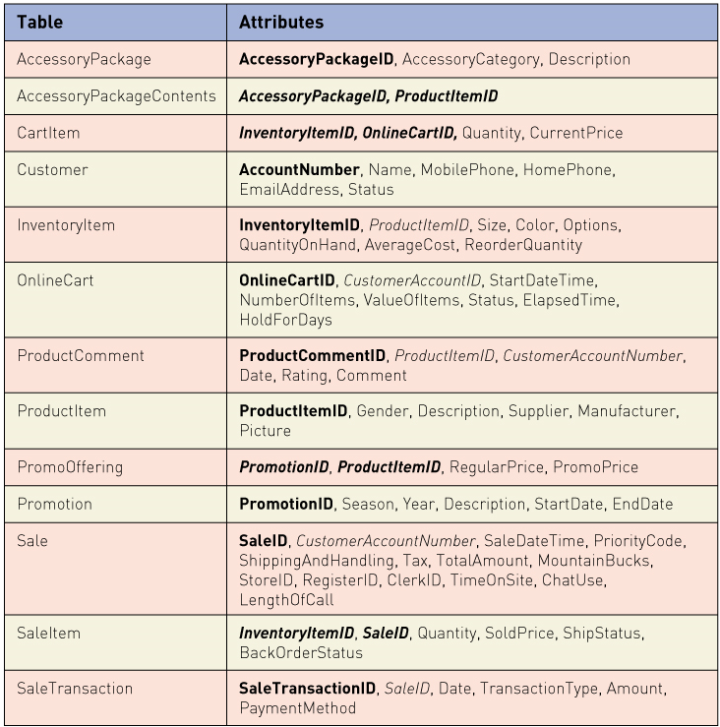
Final Tables Specialized subclasses included within OnlineCart and Sale tables

Slide 24
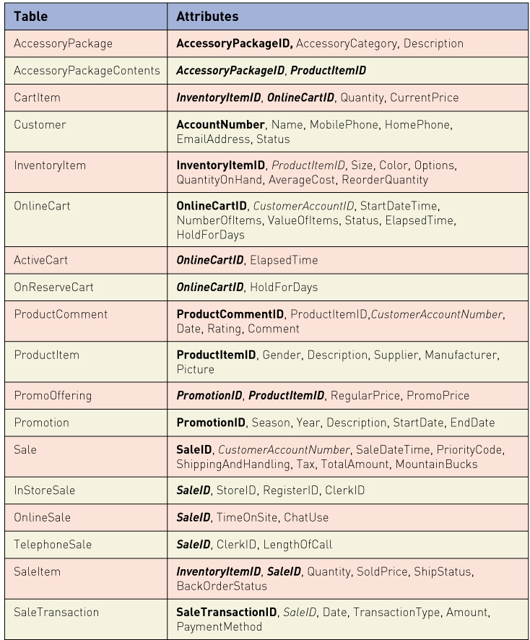
Final Tables Specialized subclasses as separate tables

Slide 25
Designing Relational Databases Referential Integrity and Schema Quality
Referential integrity -- a consistent state among foreign key and primary key values
Referential integrity constraint -- a constraint, stored in the schema, that the DBMS uses to automatically enforce referential integrity

Slide 26
Designing Relational Databases Referential Integrity and Normalization
A normalized relational database schema has these features:
Flexibility or ease of implementing future data model changes
Lack of redundant data
Protects against insertion, deletion and update anomolies
Normalization -- a formal technique for evaluating and improving the quality of a relational database schema
First Normal Form –
Second Normal Form –
Third Normal Form –

Slide 27
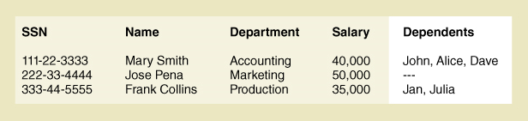
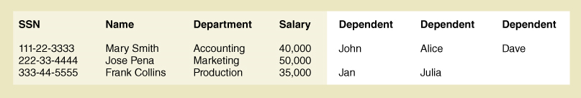
First Normal Form
A table is in first normal form if every field contains only one value.
Not multiple values in an attribute
Not varying number of columns

Slide 28
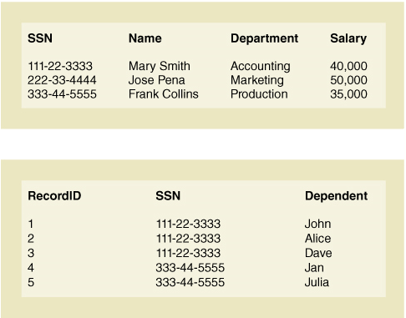
First Normal Form - Solution
Solution is to put multivalued attribute in a separate table.

Slide 29
Functional Dependency
A relationship between attributes such that the values in the first attribute (or set) always determine the values in the second attribute (or set)
Attribute B is functionally dependent on attribute A if for each value of attribute A there is only one corresponding value of attribute B.
Written as FD: A → B.
Also stated as A functionally determines B

Slide 30
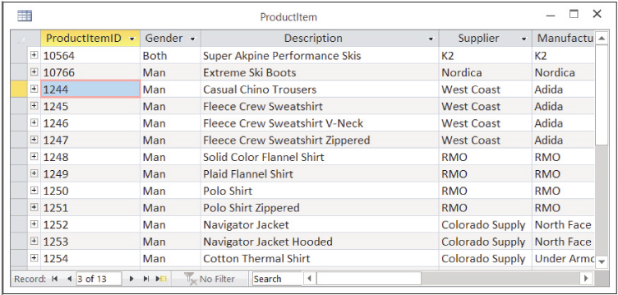
Functional Dependency
ProductID → Supplier
But NOT Supplier → ProductID

Slide 31
Second Normal Form
A table is in Second Normal Form if it is First Normal Form and each non-key attribute is only functionally dependent on the entire primary key.
This situation only arises with tables that have multiple attribute keys

Slide 32
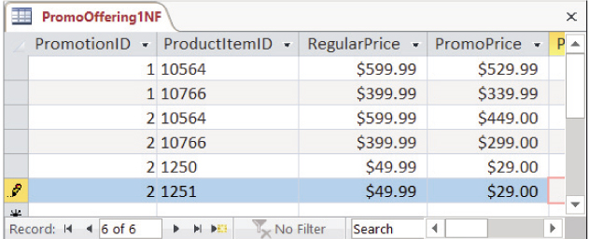
Second Normal Form
PromoOffering table is NOT in 2NF
PromotionID, ProductItemID → PromoPrice
ProductItemID → RegularPrice -- Violation of 2NF
Solution is to remove RegularPrice from this table

Slide 33
Third Normal Form
A table is in Third Normal Form if it is in 2NF and NO non-key attribute (or set) is functionally dependent on any other non-key attribute (or set)
In other words, no FDs among any non-key attributes

Slide 34
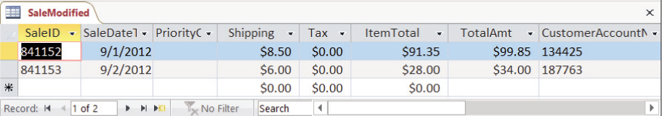
Third Normal Form
This version of Sale table violates 3NF
Shipping + Tax +Item Total = TotalAmt
i.e., FD: Shipping, Tax, ItemTotal → TotalAmt
Solution is to remove TotalAmt. It is not needed

Slide 35
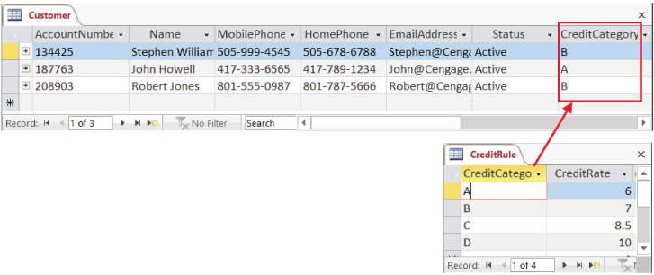
Third Normal Form - Solution
Another solution is to either move offending attribute to a new table.
Violation = Customer table had CreditCategory and CreditRate
Solution = Make new table of CreditRule with CreditRate

Slide 36
Data Types
The data type defines the storage format and allowable content of an attribute (field)
Primitive data types – data types supported directly by the DBMS
Complex data types – combinations or compositions of primitive data types. User defined

Slide 37
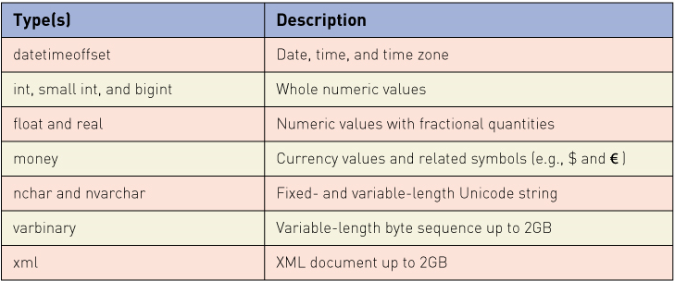
Standard Primitive Data Types

